Slide 1

MealMaker

Slide 2
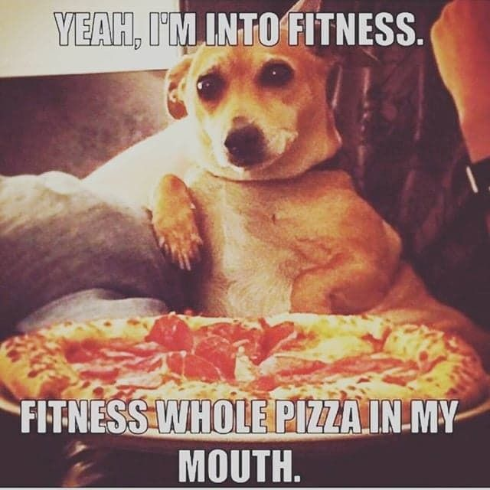

Slide 3

”…but I don’t have time to calculate
my meal’s nutrition”

Slide 4


Slide 5
At MealMaker we want to help make your meal…

Slide 6

…and your day!

Slide 7
Front End Squad
Shelby Deel
Will Hilliard

Slide 8
Back End Squad
Quinton Jones
Jeremy Simpson

Slide 9

Challenges???
Psssh!

Slide 10

Need More Time!!!

Slide 11


Slide 12
MealMakerV2
New Features
Login from the NavBar
A better picture API
Predictive Text on the Food Input Box
More responsive on Android devices

Slide 13
MealMaker

